Slide 1


Global Economic and Demographic Trends Analysis
Done By:
Yashwanth K
NOV - DA & DS
05-03-2025

Slide 2
PROJECT DESCRIPTION
Objective:
Analyze and derive insights from global data.
Data Processing Steps:
Connect data sources
Clean and transform data
Perform basic descriptive statistical analysis
Visualization:
Create interactive visualizations and Dashboards
Highlight key insights

Slide 3
Data Sets
Countries_world – Sql
Meta Dataset – CSv - Excel
Gdp-(1960-2016) – XML - Excel
Population Per Country – CSV - excel

Slide 4
Data Cleaning
Steps:
Excel cleaning
Power-BI Power query cleaning
Handled Missing values
Removed blank rows and Duplicates
Changed correct data format & Data Types
Transform the Data Table

Slide 5
Statistical Analysis
Population
GDp
Infant mortality rate
Literacy rate
Growth trends

Slide 6
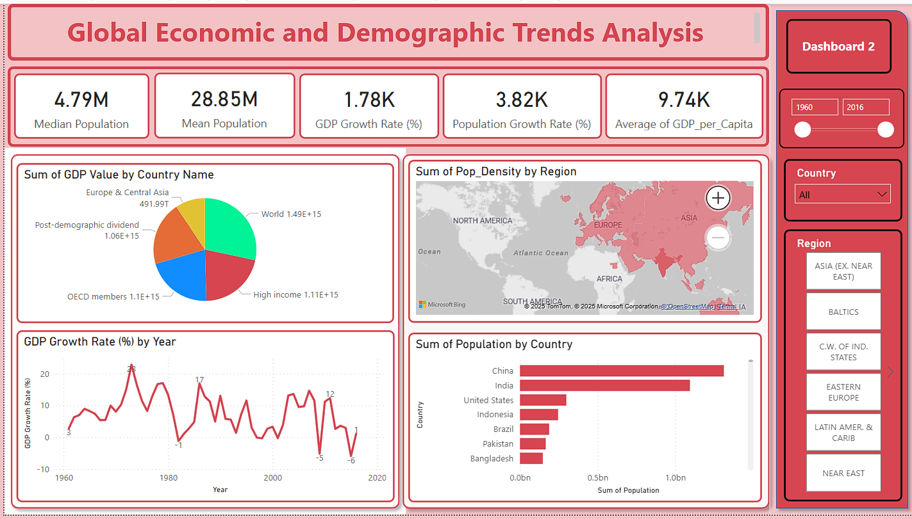

Slide 7
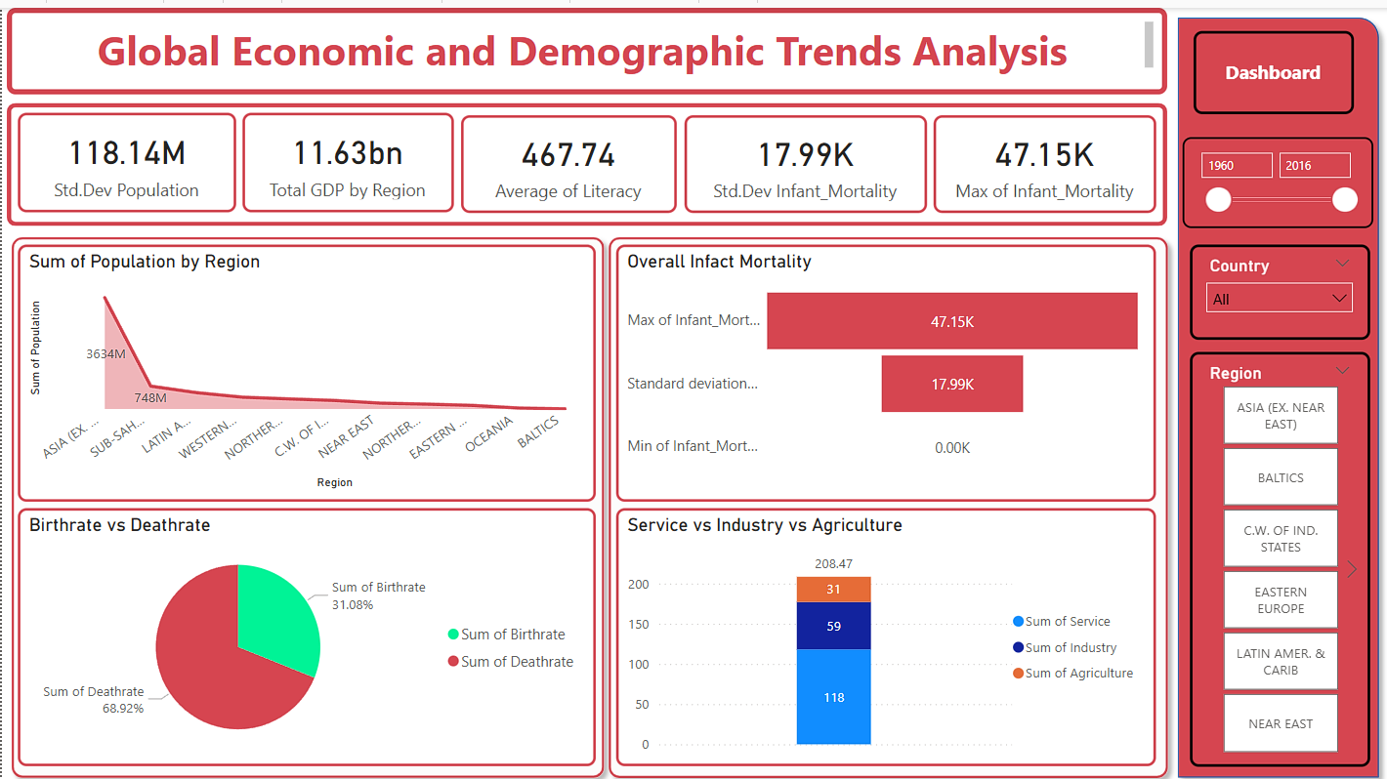

Slide 8
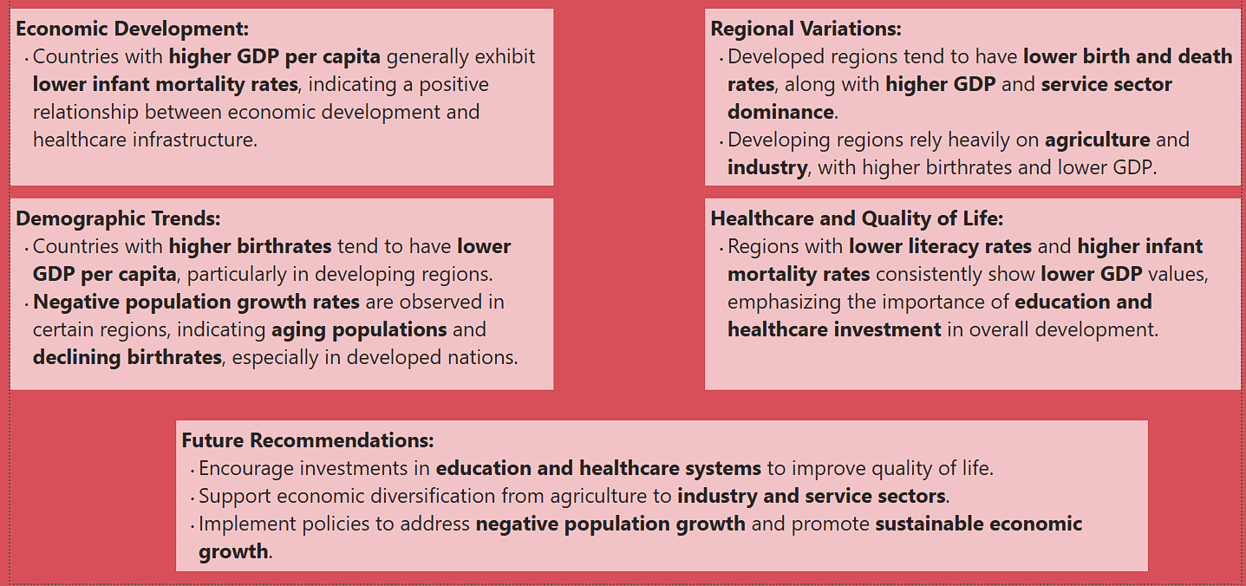
Insights & Conclusion

